Slide 1

A+ Guide to Managing and Maintaining your PC, 6e
Chapter 13
Supporting Windows 2000/XP Users and Their Data

Slide 2
Objectives
Learn how to set up and support Windows 2000/XP user accounts
Learn about some tools useful when supporting users and their data
Learn how to maintain a hard drive and keep good backups

Slide 3
Introduction
Importance of privileges assigned to user account
Determines what a user is allowed to do
Topics to cover:
How to set up and support a user account
Windows user support tools
Supporting the hard drive

Slide 4
Managing User Accounts
A user account is required to log onto Windows
Skills needed to manage user accounts:
Ability to setup user accounts
Ability to transfer user files and settings

Slide 5
Understanding and Setting Up User Accounts
User account: defines a user to Windows
Permissions: specify access for a user account
Global user accounts (or domain user accounts):
Created by an administrator
Stored in the SAM database and the domain controller
Enables user to log on to any PC in networked domain
Local user account:
Created by an administrator on a local computer
Permissions and rights apply to a local PC only

Slide 6
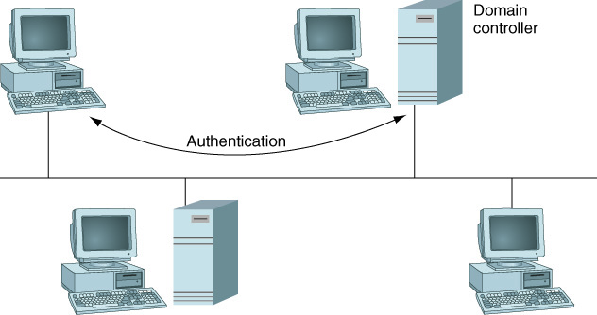
Figure 13-1 On a domain, a user account login is managed by the domain controller
Figure 13-1 On a domain, a user account login is managed by the domain controller
Figure 13-1 On a domain, a user account login is managed by the domain controller

Slide 7
Understanding and Setting Up User Accounts (continued)
Built-in user accounts created when OS is installed:
The built-in administrator account
The built-in guest account
User groups:
Administrator: used to perform all administrative tasks
Backup Operator: used to backup and restore files
Power User: used to perform some administrative tasks
Limited User: provides limited read and write access
Guest: provides limited access to files and resources

Slide 8
Table 13-1 Actions permitted for three account types

Slide 9
Understanding and Setting Up User Accounts (continued)
Access control
To access a networked PC, account on PC is required
Cacls command: used to view/change access control
User profile: created after a user logs on the first time
Items used by administrator to manage user profiles:
Group profile: a profile that applies to a group of users
Roaming user profile: a profile stored on a server
Mandatory user profile: a type of roaming user profile
View user profiles on a PC using System Properties

Slide 10
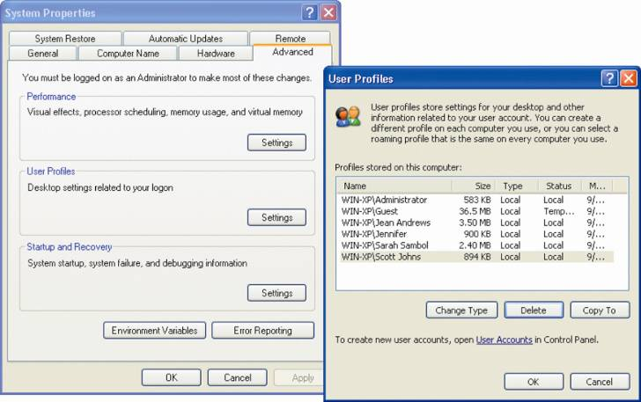
Figure 13-5 View all user profiles stored on this PC using the System Properties window

Slide 11
Understanding and Setting Up User Accounts (continued)
Guidelines for setting up user accounts:
User name for logon can consist of up to 15 characters
Passwords can be up to 127 characters
User accounts can be set up with or without passwords
Passwords can be controlled by the administrator
Logon options for PCs in a Windows XP workgroup
Welcome screen
Logon window (by pressing Ctrl+Alt+Del)
Fast User Switching Enabled (or Disabled)
Automatic logon (Welcome screen does not appear)

Slide 12
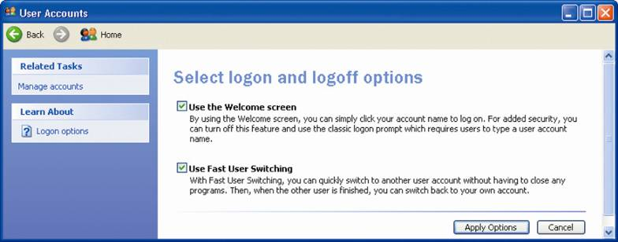
Figure 13-10 Options to change the way users log on or off

Slide 13
Understanding and Setting Up User Accounts (continued)
Tools used by administrator for changing a password:
Computer Management console
User Accounts applet
Problem with resetting a user password
Access to encrypted files and Internet passwords is lost
Forgotten password floppy disk
An alternative to resetting a password
Created through User Accounts applet

Slide 14
Transferring User Files and Preferences to a New PC
Avoid process of manually copying files and settings
The Files and Settings Transfer Wizard
Designed for the user rather than the administrator
Located on the Windows XP setup CD (Fastwiz.exe)
The User State Migration Tool (USMT)
Command-line tool designed for administrators
scanstate: copies data from old PC to server or drive
loadsate: copies data to the new PC

Slide 15
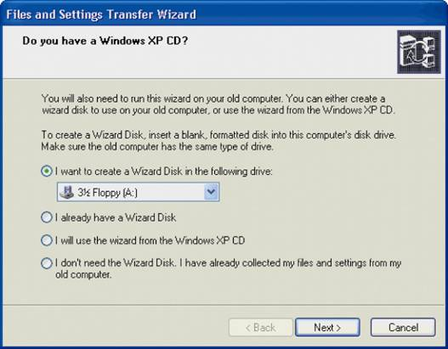
Figure 13-15 On the new computer, the Files and Settings Transfer Wizard can be used to point to the location of saved files and settings

Slide 16
Tools for Supporting Users and Their Data
Support tools covered:
Command Prompt window and its commands
Task Scheduler
Group Policy
Start menu
Remote Assistance

Slide 17
The Command Prompt Window
Opening Command Prompt window:
Click Start, click Run, and enter Cmd or Cmd.exe
Filename and file extension characters used
Letters a through z
The numbers 0 through 9
Symbols: _ ^ $ ~ ! # % & – { } ( ) @ ' `
Wildcard characters
The question mark (?): wildcard for one character
The asterisk (*): wildcard for one or more characters
Example: enter a*.??? in file search box

Slide 18
The Command Prompt Window (continued)
Help: used to get information about any command
Dir: used to list files and directories
Del or Erase: used to erase files or groups of files
Copy [drive:\path\]filename [drive:\path\]filename
Used to copy files from one drive to another
Drive and path parameters are optional
Recover: used to recover file when parts are corrupted

Slide 19
Table 13-3 Sample Dir commands

Slide 20
The Command Prompt Window (continued)
Xcopy /C /S /Y /D: enhanced version of Copy
Mkdir [drive:]path or MD [drive:]path: creates directory
Chdir [drive:]path or CD [drive:]path or CD..
Used to changes the current default directory
Rmdir [drive:]path or RD [drive:]path
Used to remove a subdirectory
Attrib: used to display or change file attributes

Slide 21
The Command Prompt Window (continued)
Chkdsk [drive:] /f /r:
Reports information about a drive
Fixes file system errors and recovers data
Defrag [drive:] /S: optimizes hard drive performance
Edit [drive:path] Filename
Activates the Edit program to create and edit text files
Format drive:/v:label/q /fs: filesystem
Used to format a floppy disk

Slide 22
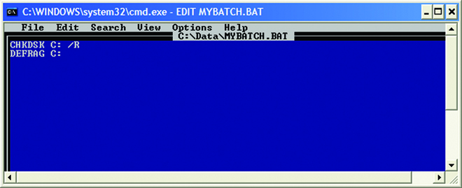
Figure 13-18 Using the Edit editor to create and edit the Mybatch.bat file

Slide 23
Task Scheduler
Used to schedule a batch routine, script, or program
Task frequency: daily, weekly, monthly, at events
Scheduled tasks stored in C:\Windows\Tasks folder
How to schedule a task:
Open the Scheduled Tasks window
Double-click Add Scheduled Task
Follow instructions in Scheduled Task Wizard
How to change settings for a scheduled task:
Right-click the task and select Properties
Change the initial and advanced settings for a task

Slide 24
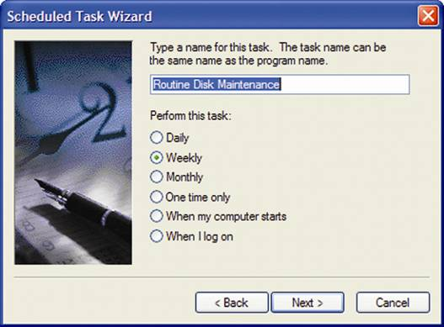
Figure 13-21 Name the task and select when it will be performed

Slide 25
Group Policy
Applied from the Group Policy console
Managed by Active Directory (if used in a domain)
Can be applied to a PC or to each user who logs on
Adding a Group Policy:
Enter Gpedit.msc in Run dialog box to open console
Go to Computer Configuration or User Configuration
Open Administrative Templates, System, and Logon
Double-click “Run these programs at user logon”
Select Enabled and then click Show
Click Add to include a script or executable program

Slide 26
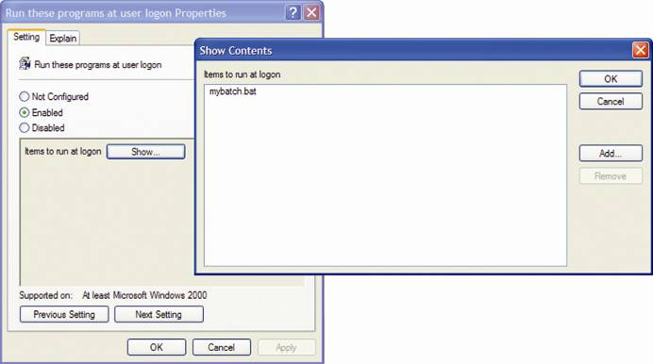
Figure 13-26 Group Policy items to run at logon

Slide 27
Controlling the Start Menu
How to control the Start menu and the Taskbar
Right-click the Start button and select Properties
The Taskbar and Start Menu Properties window opens
Customize to change the items on the Start menu
How to control items appearing in program listing
Right-click the Start button
Select Open All Users from the shortcut menu
The Start Menu folder opens as shown
Open the Programs folder to view and change items

Slide 28
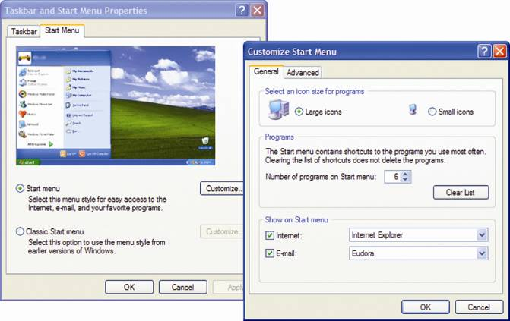
Figure 13-27 Customize the taskbar and Start menu

Slide 29
Windows XP Remote Assistance
Remote Desktop
Provides for access to a PC over the Internet
Remote Assistance
Allows a PC technician to remotely access a PC
How to use Remote Assistance
The user sends you an invitation to help
You accept the invitation and initiate the session
The user then agrees to allow you to connect
The user must agree to give you control of his desktop
Set up remote access using Help and Support Center

Slide 30
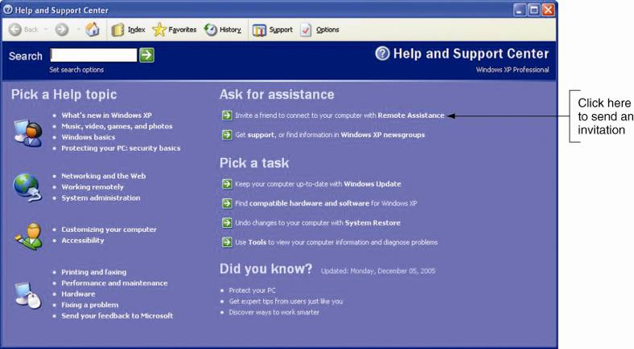
Figure 13-30 The first step in using Remote Assistance is a user sends an invitation

Slide 31
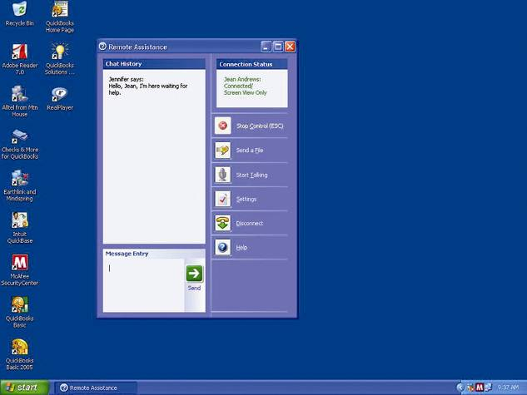
Figure 13-35 The Remote Assistance window on the user’s desktop

Slide 32
Remote Assistance (continued)
Setting up Remote Assistance for first use
Technician’s user accounts on both PCs are the same
Exception: both PCs are on the same domain
Remote Assistance must be enabled on the user’s PC
Check option in Remote tab of System Properties
Issues arising with Remote Assistance over the Web
Firewall may have to be configured to allow session
Novice user may not be able to set up a session

Slide 33
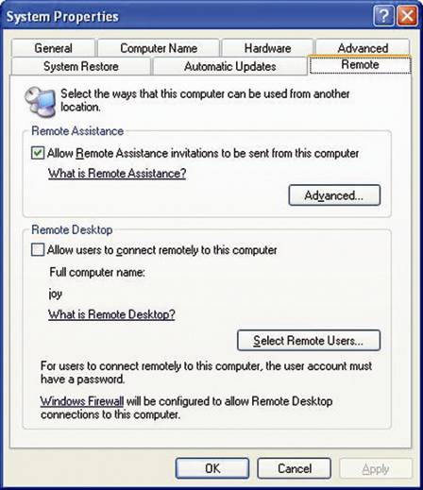
Figure 13-36 Remote Assistance must be enabled on the novice user’s computer

Slide 34
Supporting Hard Drives
Problems that develop over time:
Outdated software and unneeded data accumulate
Drive errors and failures occur
Tasks that will need to be performed:
Routine maintenance on a hard drive
Instructing users how to perform routine maintenance
Configuring a hard drive to conserve space
Keeping good backups of user data
Recovering data when it gets lost or corrupted

Slide 35
Hard Drive Routine Maintenance Tasks
Disk Cleanup: used to delete temporary files
Two ways to access Disk Cleanup:
Enter Cleanmgr.exe C: in the Run dialog box
Open Properties of drive and click Disk Cleanup
Chain: group of clusters used to hold a file
A fragmented file is stored in non-contiguous clusters
Issues with fragmentation
File access time is slowed down
Recovery utilities are less likely to reconstruct files

Slide 36
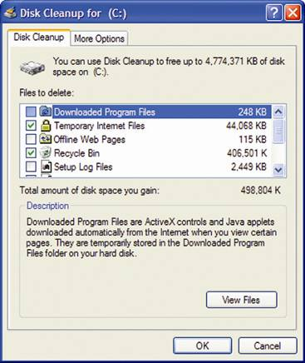
Figure 13-38 Disk Cleanup is a quick-and-easy way to delete temporary files on a hard drive

Slide 37
Hard Drive Routine Maintenance Tasks (continued)
Defragmentation: reduces drive fragmentation
One way to defrag a hard drive:
Enter Dfrg.msc in the Run dialog box
Review of the FAT file system
Directory on a drive contains a list of included files
Each entry points to first cluster in group holding a file
All clusters are linked together using pointers (a chain)
Problems that can occur: lost and cross-linked clusters
The same problems can occur in the NTFS file system
Bad sectors: corrupted portion of hard drive

Slide 38
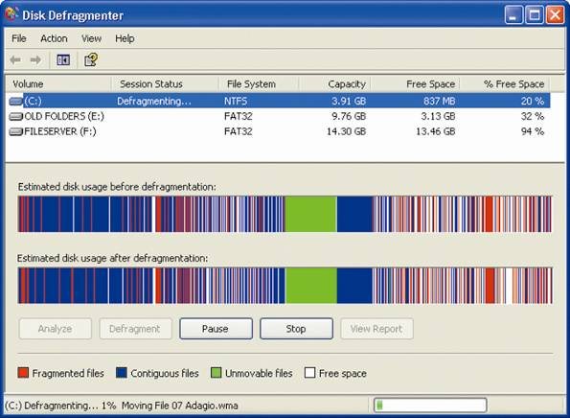
Figure 13-39 Windows XP defragmenting a volume

Slide 39
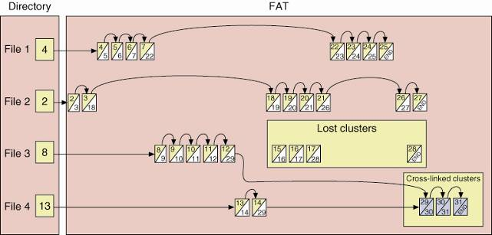
Figure 13-40 Lost and cross-linked clusters

Slide 40
Hard Drive Routine Maintenance Tasks (continued)
Error checking and repair from the Windows desktop:
Open the Properties dialog box of target drive
Click the Tools tab and then click Check Now
The Check Disk dialog box opens
Check the “Automatically fix file system errors” box
Check “Scan for and attempt recovery of bad sectors”
Click Start
The Windows 2000/XP Chkdsk command
Command line tool used to check for disk errors

Slide 41
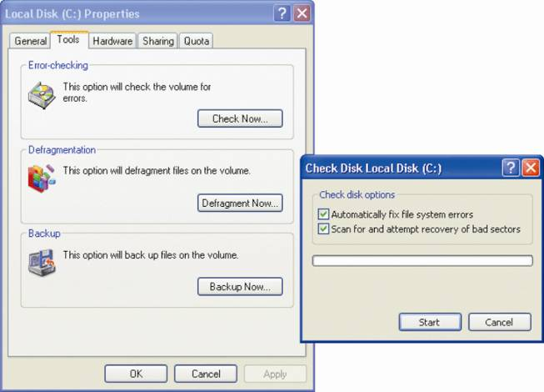
Figure 13-41 Windows XP repairs hard drive errors under the drive’s Properties window using Windows Explorer

Slide 42
Conserving Hard Drive Space
How to meet demand for more files on hard drive
Compress files, folders, or entire volumes
Compression options in an NTFS volume
Compress a single file or folder
Compress the entire volume
How to compress an NTFS volume
Open the Properties dialog box of the drive
Check the “Compress drive to save disk space” box
Check options in Confirm Attribute Changes dialog
Compress single file/folder in Advanced Attributes

Slide 43
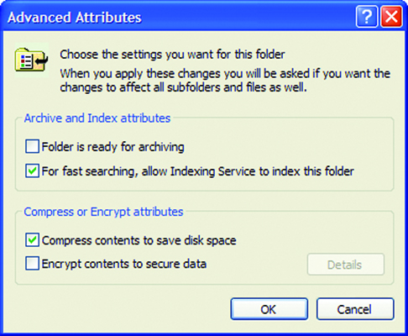
Figure 13-43 Compress a folder using the Advanced Attributes dialog box for the folder

Slide 44
Conserving Hard Drive Space (continued)
Disk quota: limits the disk space a user can access
The disk quota set applies to all user accounts
You can only set disk quotas if you are using NTFS

Slide 45
Making Backups
Backup: extra copy of data or software file
A few tips for creating backup and recovery plans
Decide on the backup media; e.g., tape, CD, DVD
Back up data after every four to ten hours of data entry
Always record your regular backups in a log
Perform backups using the Backup Utility
Options for scheduled backups:
Full, copy, incremental, differential, and daily
Restore and Manage Media tab of Backup Utility
Used to recover files, folders, or an entire drive

Slide 46
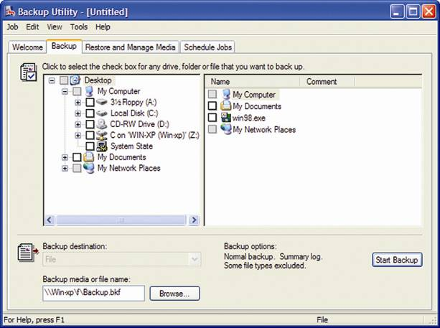
Figure 13-48 You can perform an immediate backup from the Backup tab

Slide 47
Solving Hard Drive Problems
Two types of problems:
Those that prevent the hard drive from booting
Those that prevent data from being accessed
Problem-solving process
Interview the end user
Prioritize what you have learned
Use all available resources; e.g., Task Manager
A few ways to recover lost data
Try treating a corrupted file as a text file
Try data recovery software

Slide 48
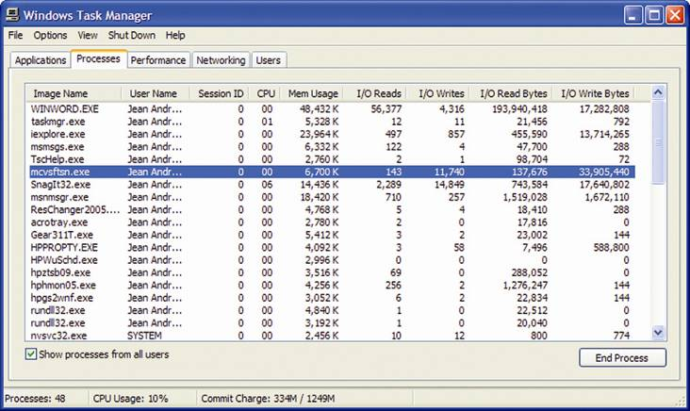
Figure 13-52 Look for an application that might be causing slow drive performance by excessive reading and writing to the hard drive

Slide 49
Summary
User account: defines a user to Windows 2000/XP
Types of user accounts: global user, local user
Main user groups: Administrator, Limited User, Guest
Manage user profiles with group profile, roaming user profile, and mandatory user profile
Command Prompt window: used to enter text commands

Slide 50
Summary (continued)
The Start menu and taskbar can be customized
Remote Assistance: gives remote access to technician
Disk utilities: Disk Cleanup, Disk Defragmenter, Error-checking
Conserve hard drive space using compression and disk quotas
Backup types: full, copy, incremental, differential, daily

